Slide 1
Analog Electronics Lab Experiment-7
Instructors name:
P3:
Ashish Kumar Varma
Sambhavi Shukla
P4:
Ankita Dixit
Premsai Regalla

Slide 2
Precision Circuit

Slide 3
Objective
To study performance of precision circuit
(a) Rectifier
Half Wave Rectifier
Full Wave Rectifier
(b) Clipper
Positive Clipper
Negative Clipper

Slide 4
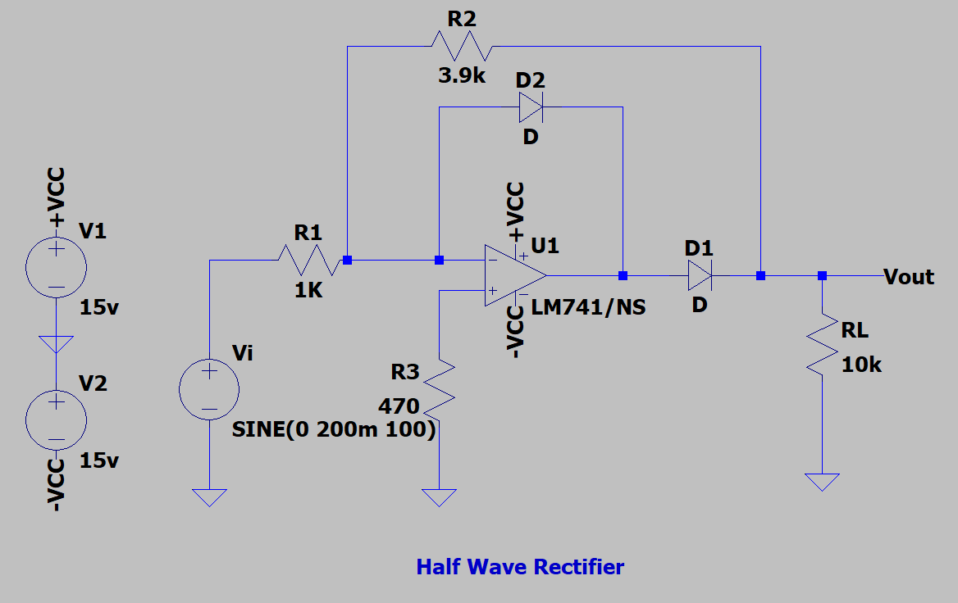
(a) Rectifier Half Wave Rectifier

Slide 5
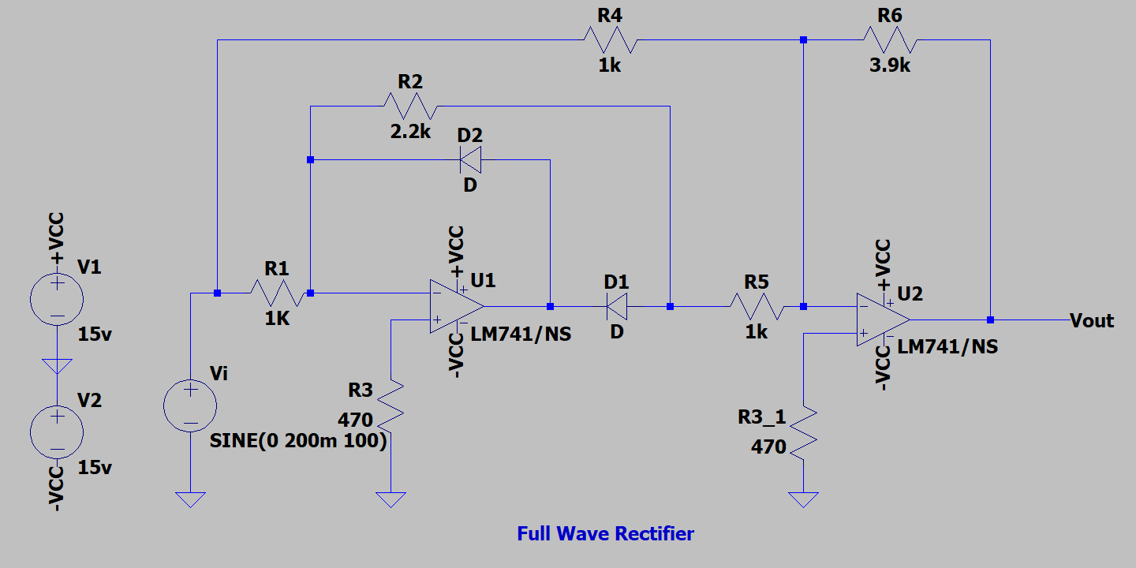
(a) Rectifier Full Wave Rectifier

Slide 6
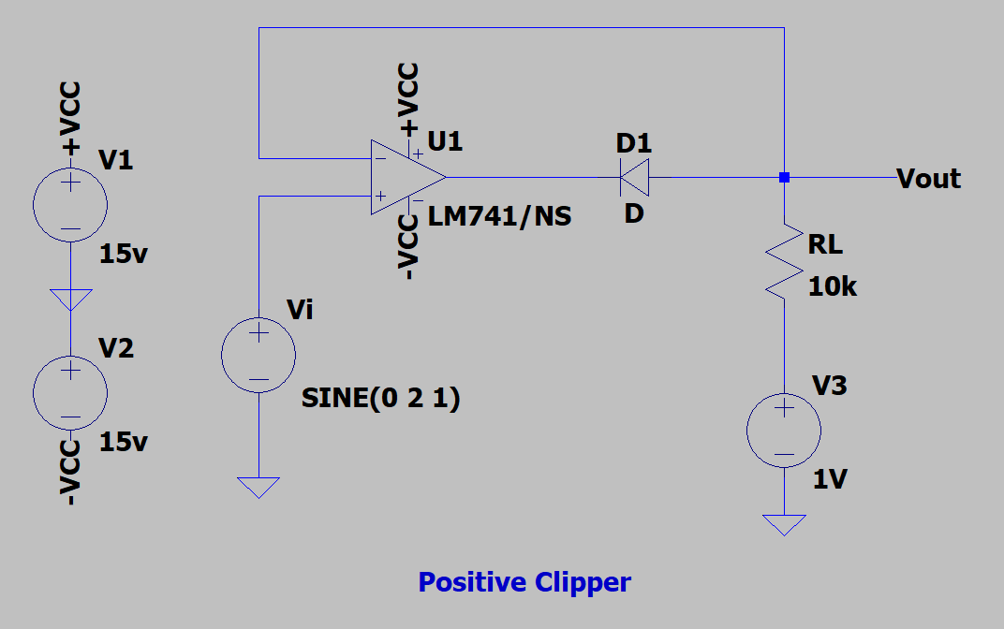
(b) Clipper Positive Clipper

Slide 7
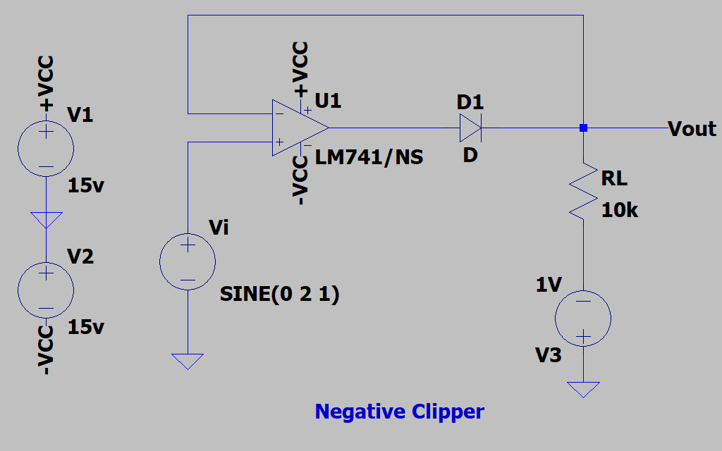
(b) Clipper Negative Clipper

Slide 8
Assignment:
To study performance of precision circuit
(a) Rectifier
Half Wave Rectifier
Full Wave Rectifier
(b) Clipper
Positive Clipper
Negative Clipper
Upload a single PDF file on Nalanda which includes
1) Circuit diagrams for rectifiers and clippers.
2) Input and output waveforms for rectifiers and clippers.
Submit the report in a single PDF format (file name should be your ID) on Nalanda within 48 hrs., after your lab section. (2 marks deduction for late submission) Personal submission on email will not be considered.

Slide 9
